Slide 1
Gradient Descent in Machine Learning

Slide 2
Gradient Descent
Gradient Descent is known as one of the most commonly used optimization algorithms to train machine learning models.
Gradient descent is also used to train Neural Networks.
It minimizes errors between actual and expected results.

Slide 3
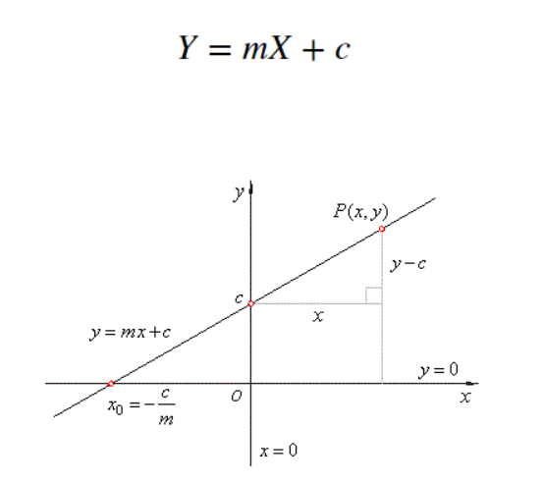
Linear Regression
Let X be the independent variable and Y be the dependent variable
Our goal is to determine the value of m and c, such that the line corresponding to those values is the best fitting line or gives the minimum error.

Slide 4


Loss Function
The loss is the error in our predicted value of m and c.
Our goal is to minimize this error to obtain the most accurate value of m and c.
The Mean Squared Error function to calculate the loss.
Find the difference between the actual y and predicted y value(y = mx + c), for a given x.
Square this difference.
Find the mean of the squares for every value in X.
Here yᵢ is the actual value and ȳᵢ is the predicted value
Let’s substitute the value of ȳᵢ:

Slide 5
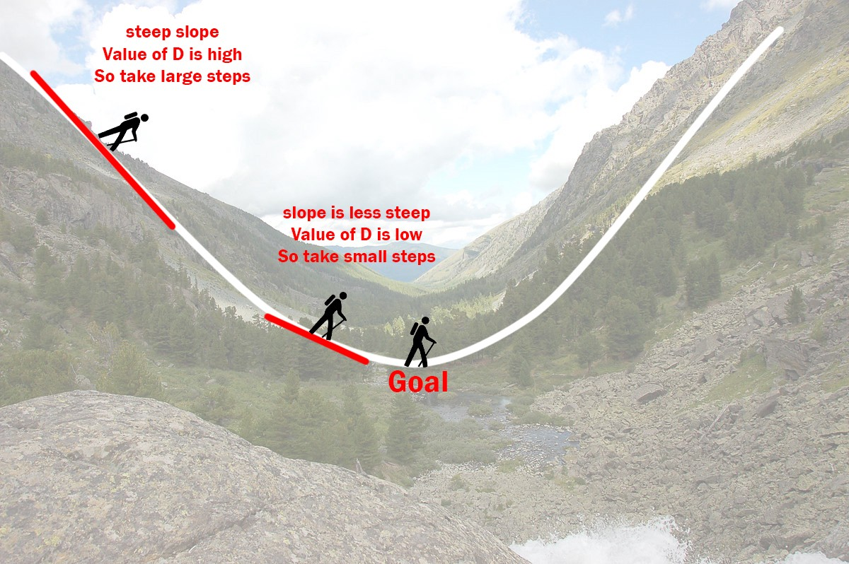
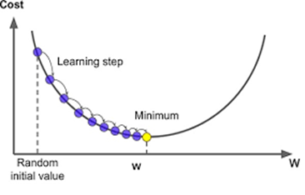
Understanding Gradient Descent

Slide 6
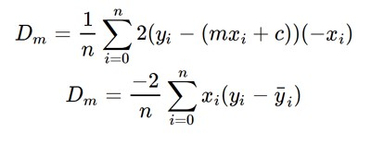

Gradient Descent
1.Initially, let m = 0, c = 0 and L-is the Learning rate.
learning rate-controlling how much the value of “m” changes with each step. The smaller the L, the greater the accuracy.
2.Calculating the partial derivative of loss function wrt “m” and giving current values of x, y , m, and c to get the derivative D.
Dₘ is the value of the partial derivative with respect to m. Similarly, lets find the partial derivative with respect to c, Dc :

Slide 7
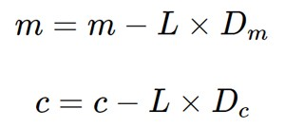
Gradient Descent
3. Now we update the current value of m and c using the following equation:
4. Repeat this process until our loss function is a very small value or ideally 0 (which means 0 error or 100% accuracy). The value of m and c that we are left with now will be the optimum values.

Slide 8
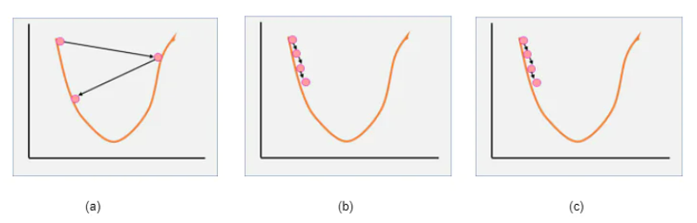
Learning rate Difference
(a) Large learning rate, (b) Small learning rate, (c) Optimum learning rate

Slide 9
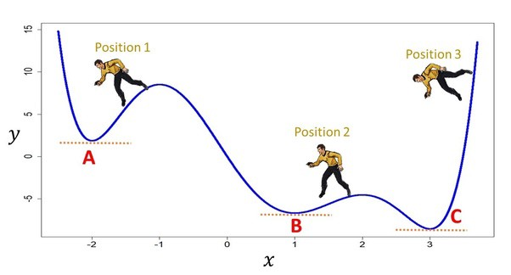
Global Minimum
In the case of the linear regression model, there is only one minimum and it is the global minimum
The local minimum reached depends on the initial coefficients taken into consideration. Here, point A, B are termed Local Minimum and point C is Global Minimum.

